Slide 2
Objectives
Explain how a range of solutions are used to help keep data safe from security threats, including:
Access levels
Anti-malware, anti-virus, anti-spyware
Authentication
Automatic software updates
Checking the spelling and tone of communications
Checking the URL attached to a link
Firewalls and proxy servers
Privacy settings
Secure socket layer (SSL) security protocol

Slide 3


Starter
Computers are vulnerable to many threats such as:
Brute-force attack
Data interception
Distributed denial of service (DDoS) attack
Malware (virus, worm, Trojan horse, spyware, adware, ransomware)
Pharming, phishing, social engineering
What methods do you use at school or home to reduce the risk of these threats?

Slide 4
Preventing vulnerabilities
There are many ways that vulnerabilities are protected against – in particular:
penetration testing
anti-malware software – including anti-virus software
firewalls
user access levels
passwords
encryption
physical security

Slide 5

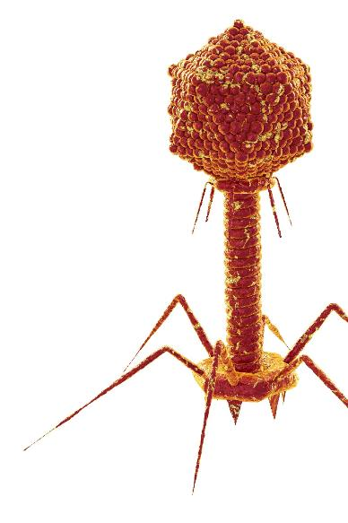
Anti-malware software
Anti-malware, anti-virus and anti-spyware software will detect malware such as viruses, worms, trojans, and spyware
When a virus or new malware is detected it is sent to the anti-virus company
They verify it is malware then create a signature of the virus
They then add it to their virus database and tell computers to run an update
Viruses can morph to avoid detection. This makes it harder to create a signature

Slide 6
Encryption
Encryption is a way of securing data so that it cannot be read without the encryption key
Passwords stored by websites are almost always stored in an encrypted form
If a hacker obtains the data in the password database, they won’t be able to easily read the passwords
Devices and computers can also have their storage and hard disk data encrypted
How do you know if a website you are using is encrypting the communication between your computer and the website?

Slide 7
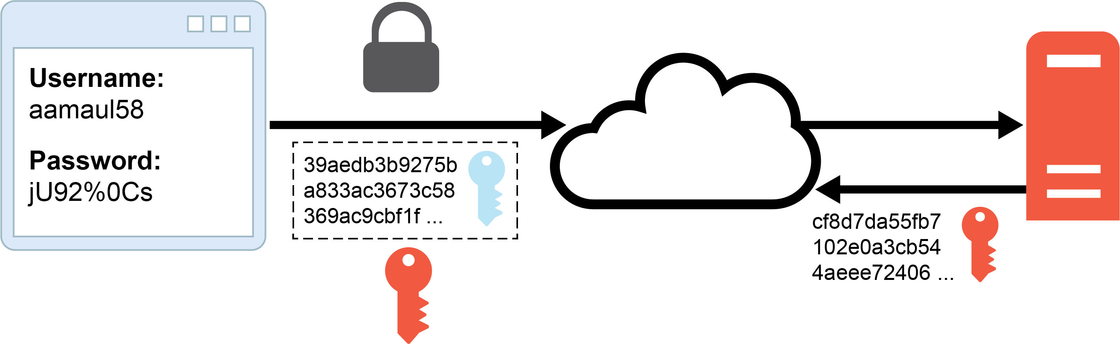
Encryption of transmitted data
Websites using HTTPS (HyperText Transfer Protocol Secure) encrypt the connection to the server
Your web browser sends its key and form data, encrypting it with the server’s key
The server encrypts the web page you request using your web browser’s key

Slide 8
Secure Sockets Layer (SSL)
Secure sockets Layer is a protocol that ensures cryptography is used when transmitting web pages
Whilst it may be used for email and voice over IP (VoIP) it is most commonly used in making HTTPS secure
SSL certificates are purchased by the owners of websites. These verify who owns the website
Clicking on the padlock in a browser address bar usually allows you to view the certificate

Slide 9
Worksheet 6
Now complete Task 1 on Worksheet 6

Slide 10
Firewalls
Separate a trusted network from an untrusted network (normally the Internet)
Data is sent around a network in small packets of information
These packets are checked to see where they are coming from and going to
Packets that don’t match filtering rules are dropped
This is known as a packet filter
Firewalls can be run on dedicated hardware or as software

Slide 11
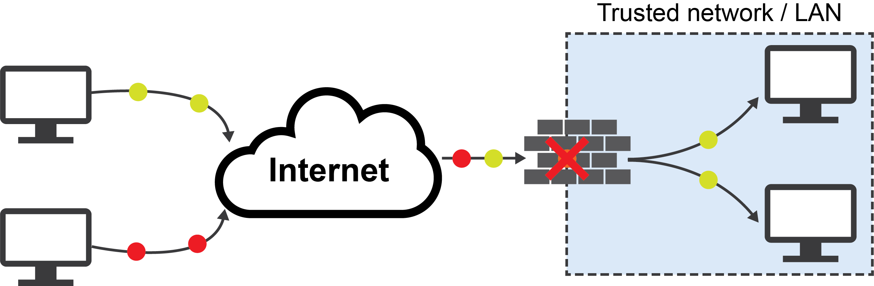
Firewalls
Firewalls may be built into your hardware
This may be a dedicated unit to the task of being a firewall
Alternatively, it may be built into other devices such as a home Wi-Fi router
The firewall will detect packets from malicious computers

Slide 12
Firewall capabilities
Firewall features:
Prevents attackers from gaining access to computers on a network
Can block certain malicious computers by filtering packets from a certain IP (Internet Protocol) address
Can prevent access to certain ports on the network. This is known as port blocking
Malicious or inappropriate websites can be blocked
Dedicated hardware firewalls are expensive
Software firewalls will slow down a computer

Slide 13
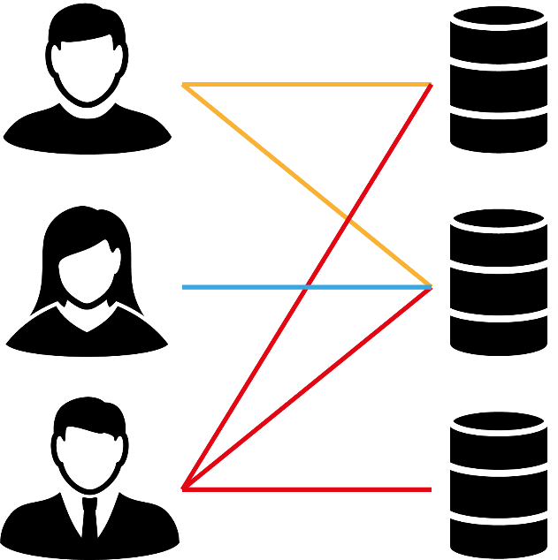
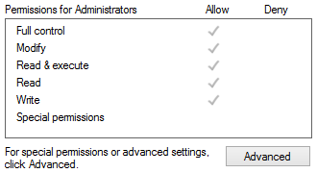
Access levels
Access rights may be set on disks, folders and even individual files
How are access rights used in school?

Slide 14
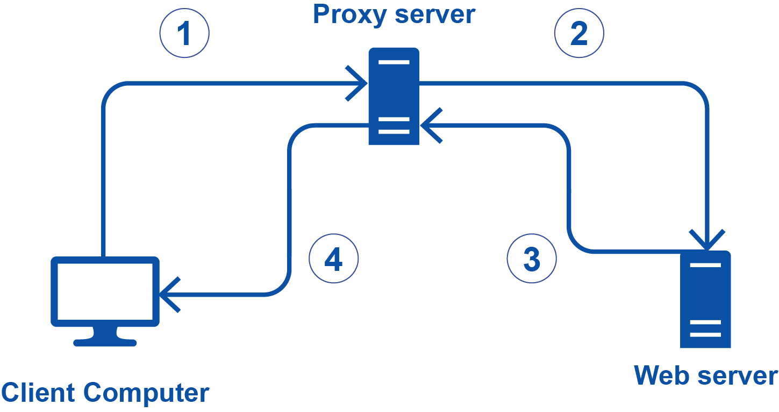
Proxy settings
One problem with using the Internet is that you need to reveal the IP address of your computer
Instead, requests may be made to a proxy server which makes requests to the server on your behalf
This allows your IP address to be hidden
This role may be carried out by a proxy server in an office or a Virtual Private Network (VPN)
If you use a public network, such as in a café or hotel, you should make use of a proxy server (this is usually a paid for service)

Slide 15
Worksheet 6
Now complete Task 2 on Worksheet 6

Slide 16

Privacy settings
Privacy settings allow you to turn off computer features to reduce the risk of hacking attempts or personal data being stolen
Some privacy settings that users may turn off include:
Turn off microphone
Turn off webcam/camera
Prevent websites accessing location data
Prevent websites tracking you
Block cookies

Slide 17
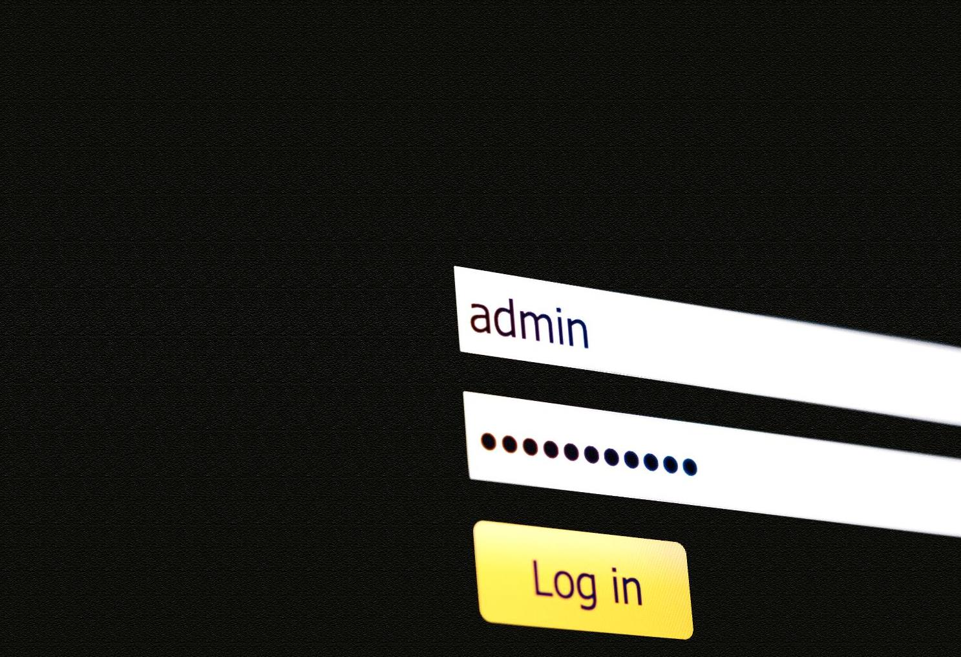
Passwords
Usernames and passwords are one of the most important ways of protecting computers and servers
They prevent unauthorised people from using the system
They also apply the correct access permissions to the user’s account

Slide 18
Case study
In December 2018, a hacking forum was found to have the largest collection of passwords ever found
Over 770 million email addresses and passwords were available
‘Collection #1’ had thousands of sources
There were over 1.1 billion email/password combinations
What are five rules for creating strong passwords?

Slide 19


Password policies
Strong passwords:
Minimum length of characters
Include at least one lowercase letter
Include at least one uppercase letter
Include at least one symbol
Change password every month
Also, make sure the password isn’t based on the following:
Names of family members, friends or pets
Words in a dictionary or place names
Holiday destinations

Slide 20
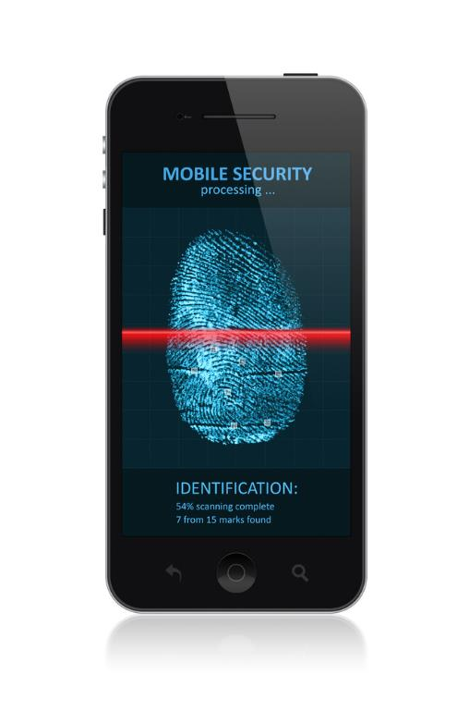
Biometric authentication
Biometrics measure a person’s physical characteristics to verify their identity
One common method of authentication used on portable devices is a fingerprint
What other biometrics can be used for authentication?
Where are these commonly used?

Slide 21
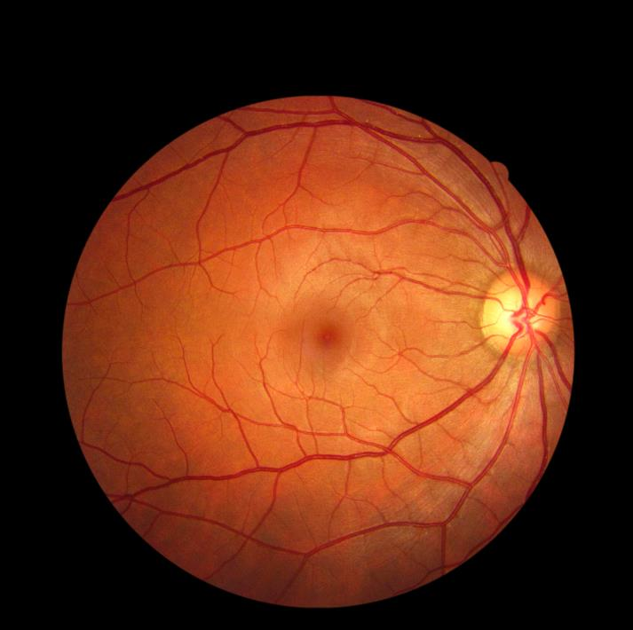
Biometric authentication
Biometric methods include:
Facial recognition – commonly now used on phones, tablets and some desktops
Retinal scans – more commonly used in high security environments
Some less commonly used methods include:
Palm vein recognition
Ear recognition
Voice recognition

Slide 22
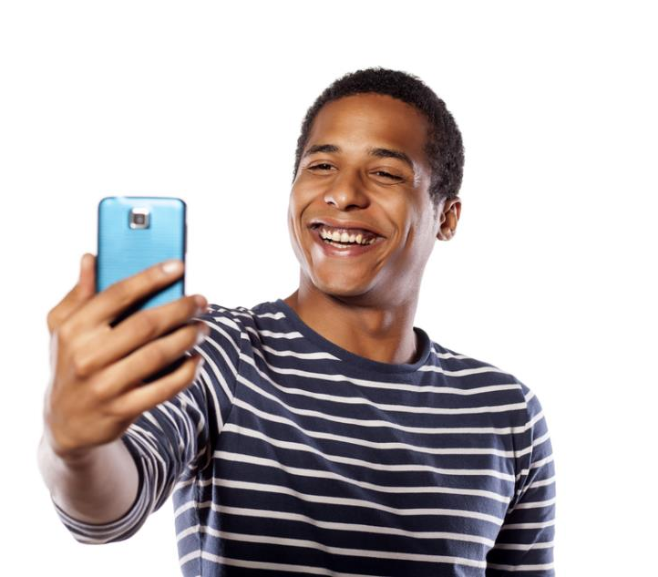
Case study: Starling Bank
When registering a new bank account users need to provide a photo of their driving licence or passport
They then need to record a short video of themselves speaking a message
This can then be used to authenticate that the person talking is the same person as that in the driving licence or passport

Slide 23

Registering a new account
When a user signs up for a service, they may be asked to enter a username and password
They are also asked to enter their email address
If, later on, they forget their password, a reminder can be sent to this email address
What happens if they enter the wrong email address when they first register?
How can the email address be authenticated when they register?

Slide 24
Email authentication
If an email address is incorrect when a user first registers, they may have no way to recover their password
On registration, an authentication email can be sent to the email address
This contains a unique web address link which needs to be clicked
Once the web page is visited, the web site knows that the user has access to the email account. It can then record that the email address has been authenticated
This technique is known as two-step verification

Slide 25
Worksheet 6
Now complete Task 3 and Task 4 on Worksheet 6

Slide 26
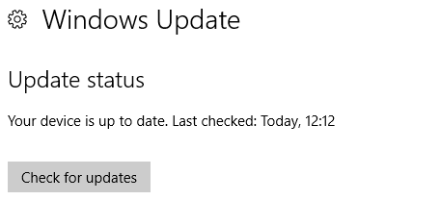
Automatic software updates
Many large companies such as Microsoft and Adobe automatically update your software whenever they make a change to it
This could happen on a daily or weekly basis
Why should you agree to automatic updates?

Slide 27
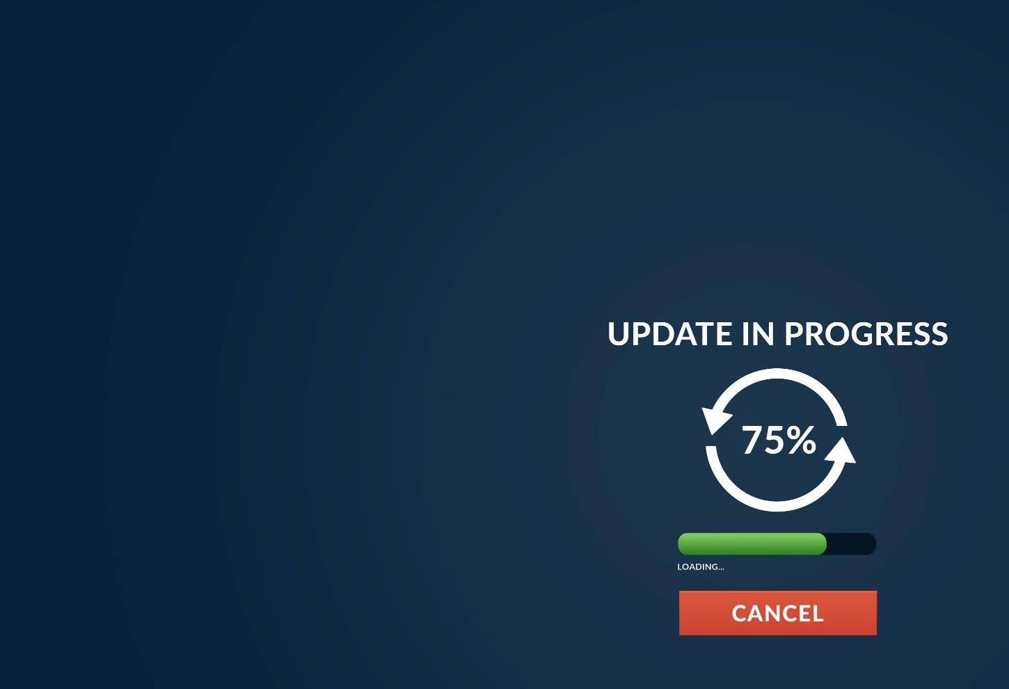

Software updates
Software updates are necessary to fix bugs
They also offer security updates
If security holes are not updated or patched, a hacker can exploit them
Virus software needs to be set to auto-update so that it always has the latest virus definitions
Operating systems should either auto-update, or be updated as soon as possible if a security update is released

Slide 28
Plenary
For each of the following, state whether it is:
A threat to a digital system
A way of protecting a digital system
Brute-force attack
Access levels
Anti-spyware
Phishing
Two-step verification
Malware
Firewalls
Privacy settings
Data interception
Proxy servers
Pharming
SSL

Slide 29

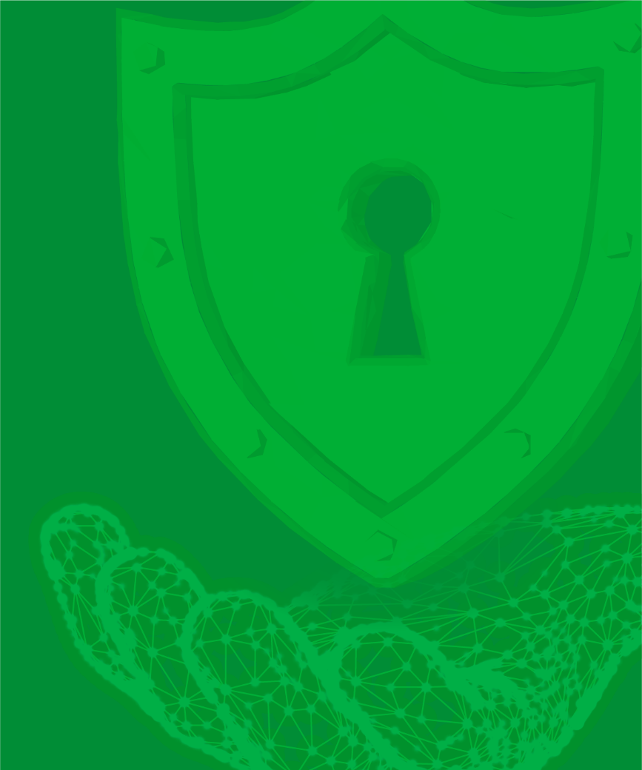
Plenary
Threats
Protections
Brute-force attack
Phishing
Access levels
Anti-spyware
Malware
Data interception
Two-step verification
Firewalls
Pharming
Privacy settings
Proxy servers
SSL

